Slide 1
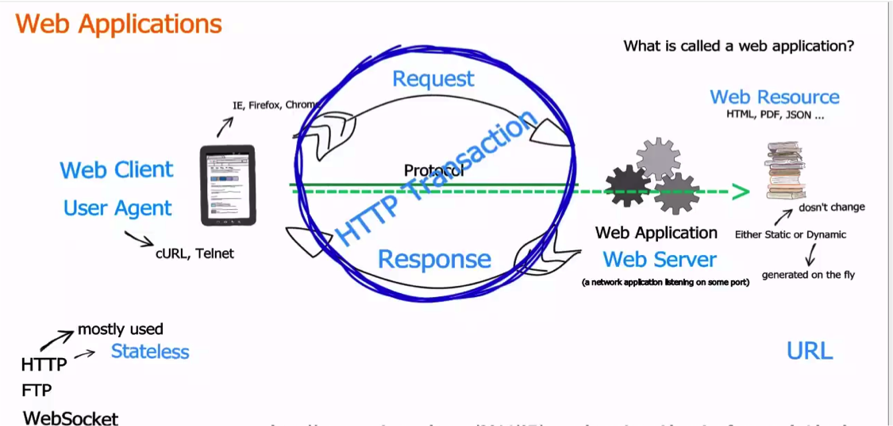
HTTP

Slide 2
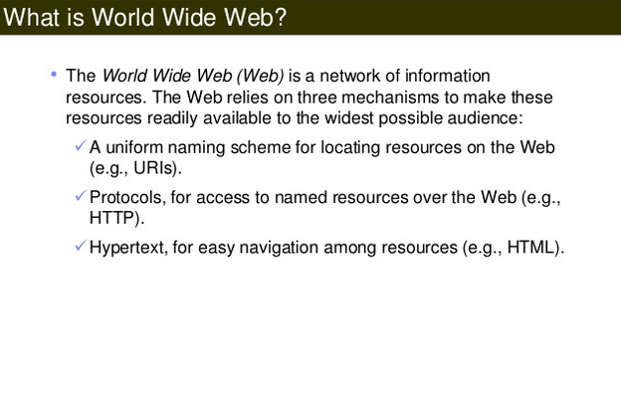
What is WWW

Slide 3
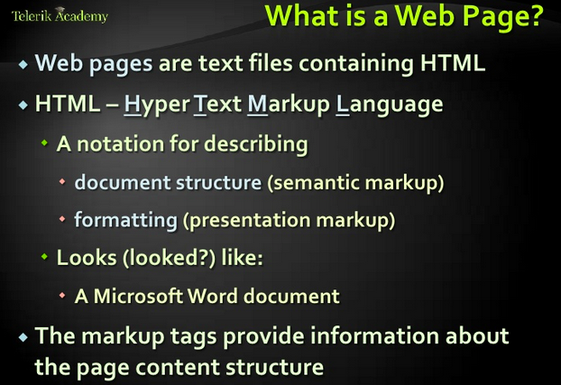
What is a Web Page

Slide 4
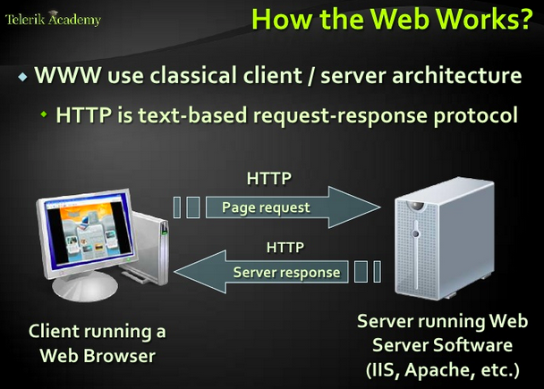
How web works

Slide 5
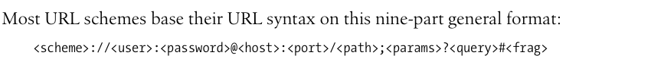
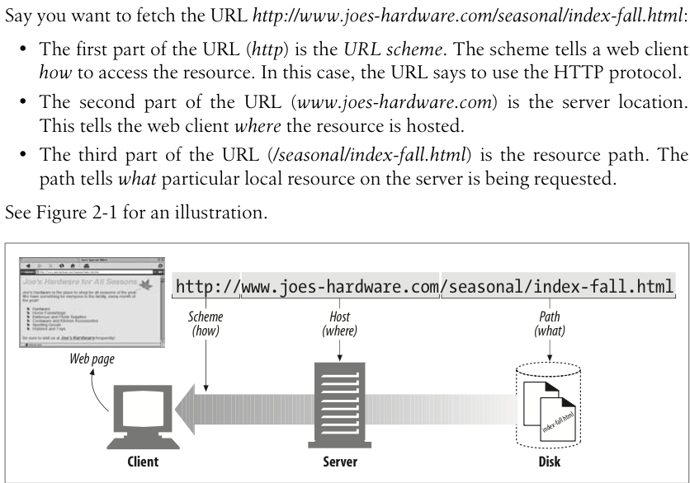
URL Format

Slide 6
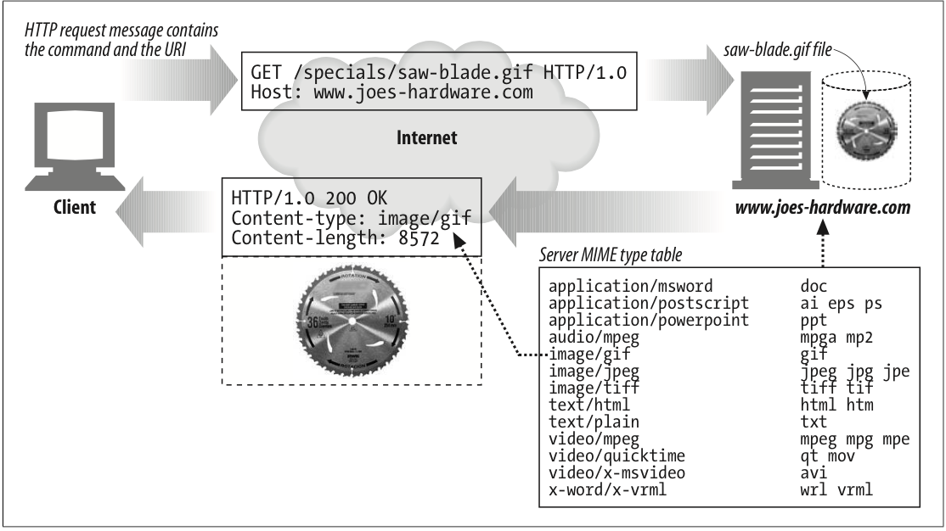
Mime Types

Slide 7
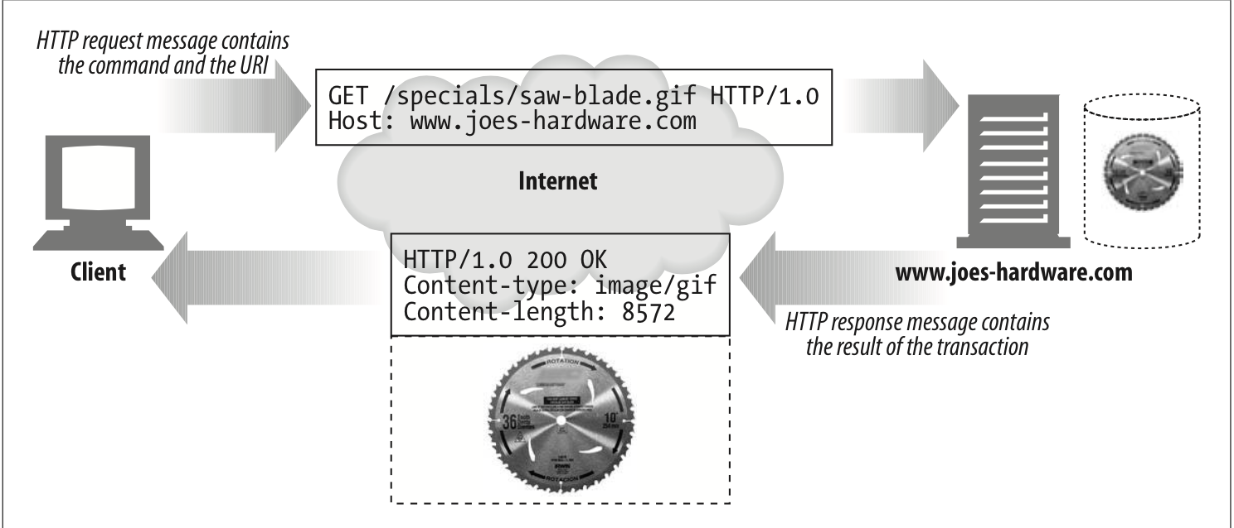
Transaction

Slide 8
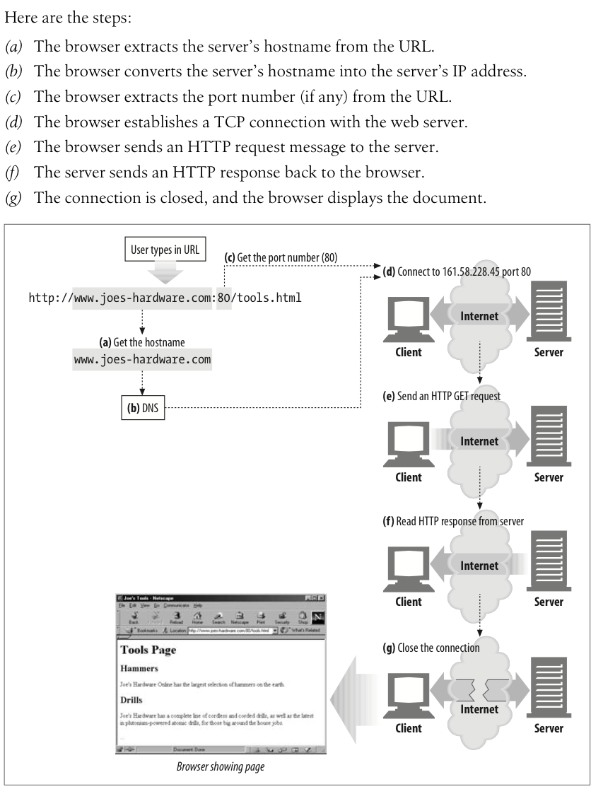
Connections

Slide 9
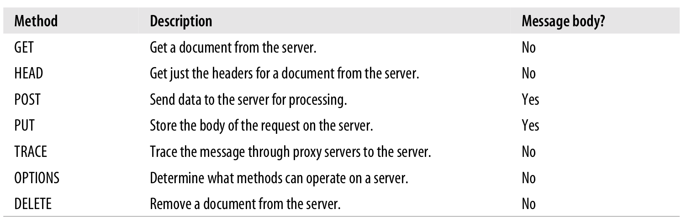
Methods & Status Codes
http://en.wikipedia.org/wiki/List_of_HTTP_status_codes

Slide 10
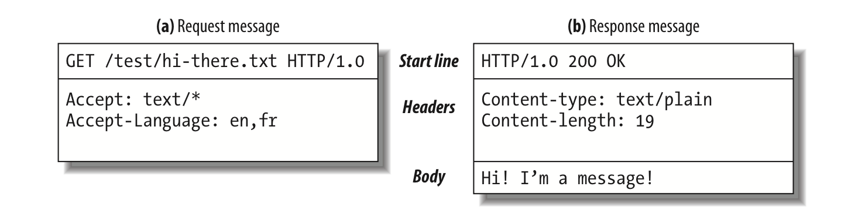
Messages

Slide 11
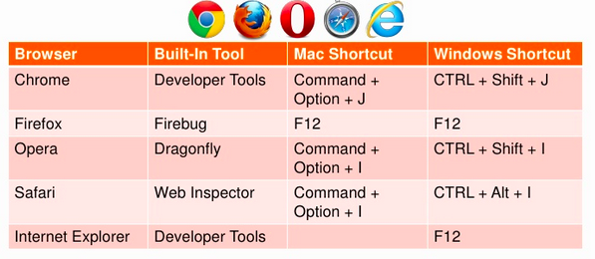
Dev Tools

Slide 12
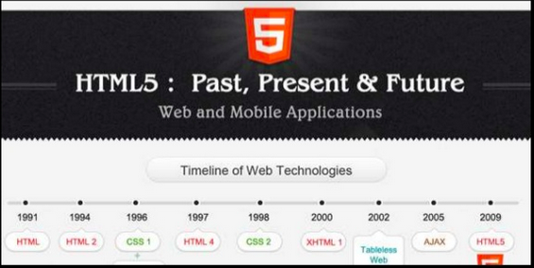
History of HTML

Slide 13
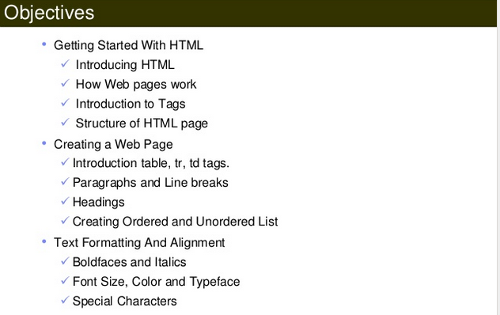
Objective

Slide 14
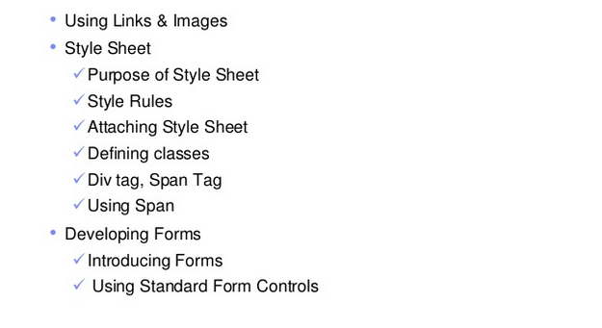
Objective ..cotinue..

Slide 15
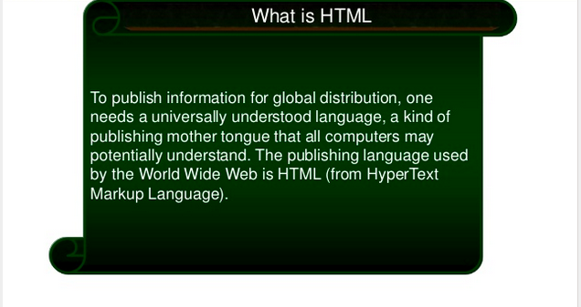
What is HTML

Slide 16
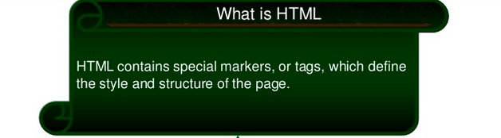
What is HTML

Slide 17
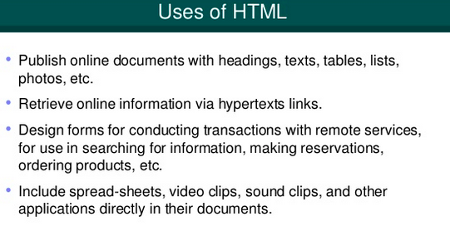
Use of HTML

Slide 18
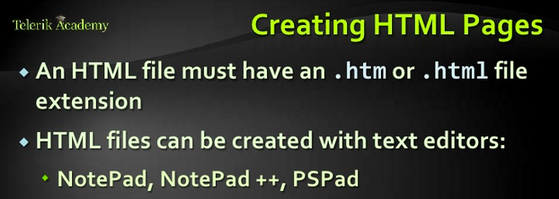
Creating Html Pages

Slide 19
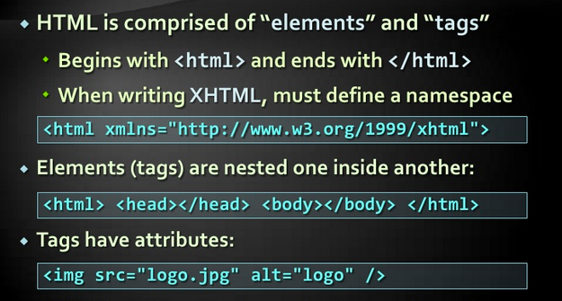
Elements & Tags

Slide 20
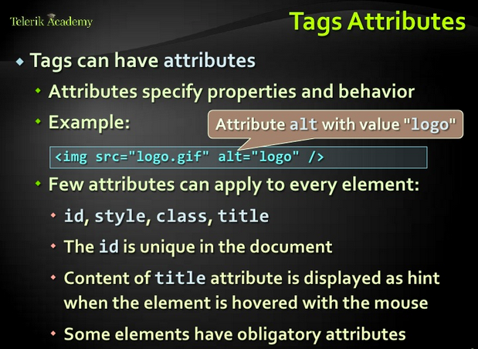
Attributes

Slide 21
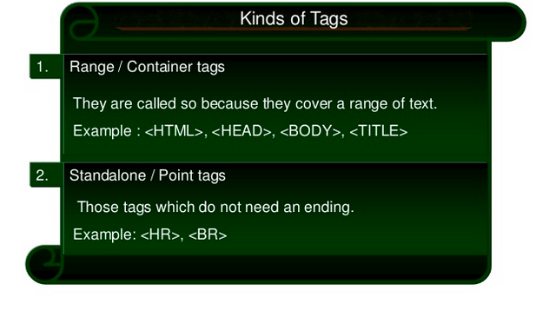
Kinds of Tags

Slide 22
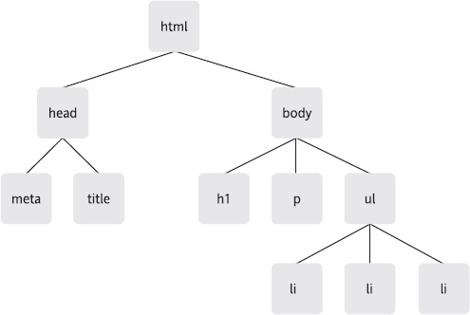
DOM

Slide 23
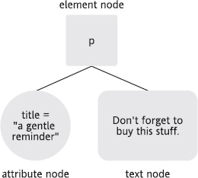
Element Node

Slide 24
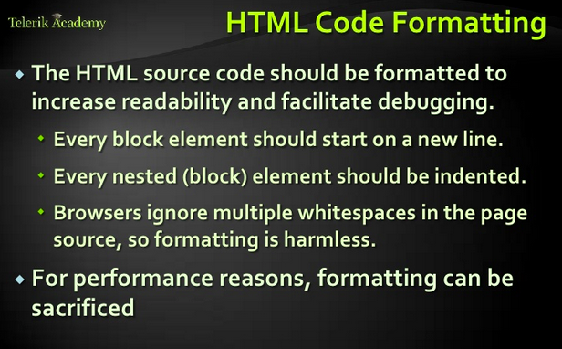
Code Formatting

Slide 25
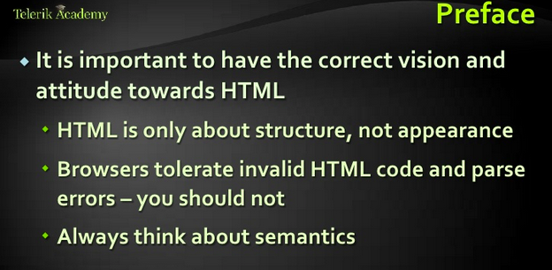
Structure

Slide 26
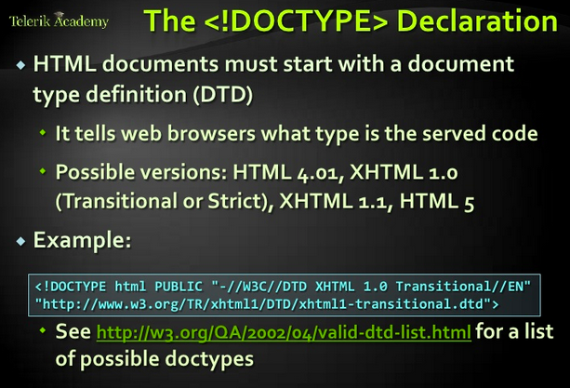
DocType

Slide 27
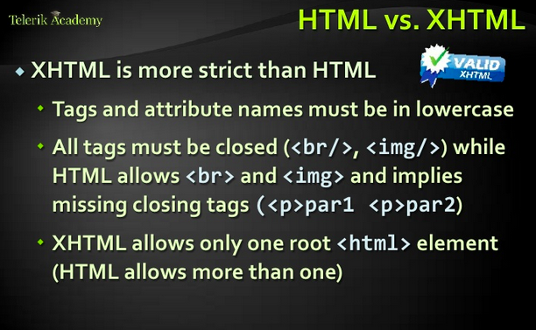
HTML Vs XHTML

Slide 28
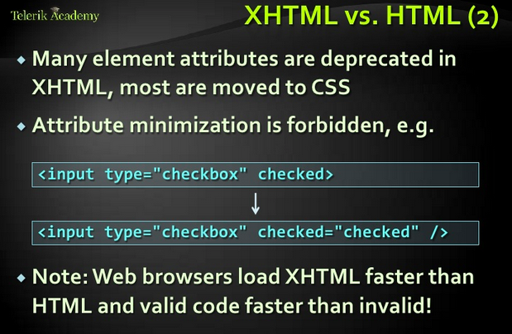
HTML Vs XHTML

Slide 29
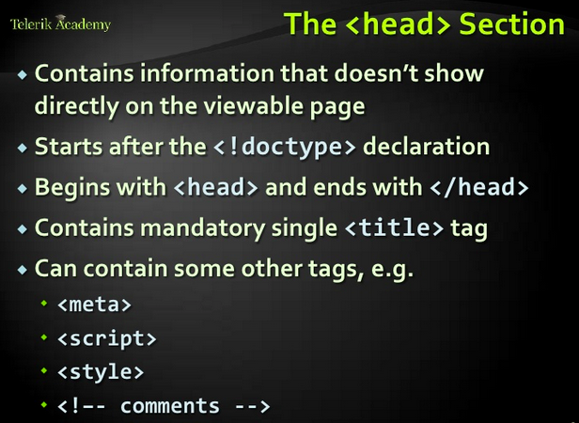
Head

Slide 30
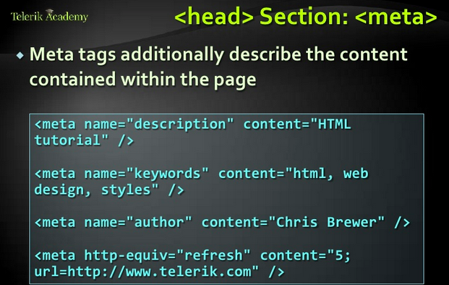
Meta

Slide 31
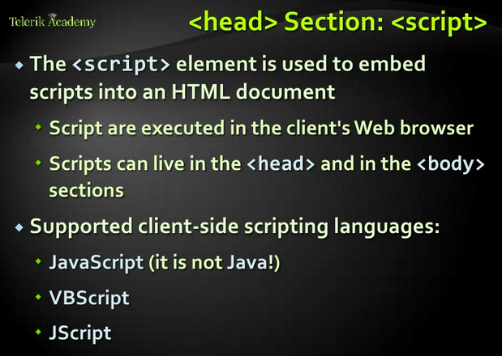
Script

Slide 32
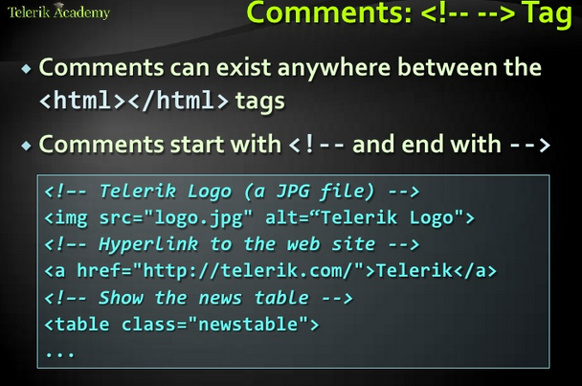
Comments

Slide 33
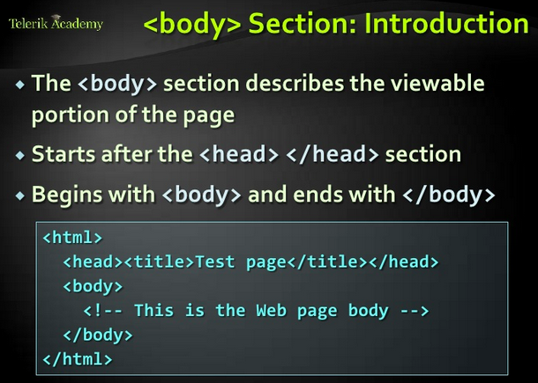
Body

Slide 34
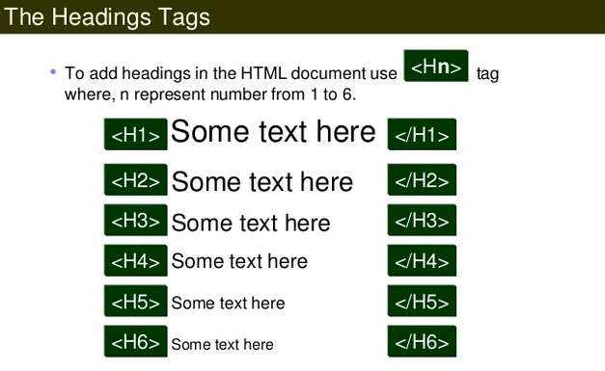
Headings

Slide 35
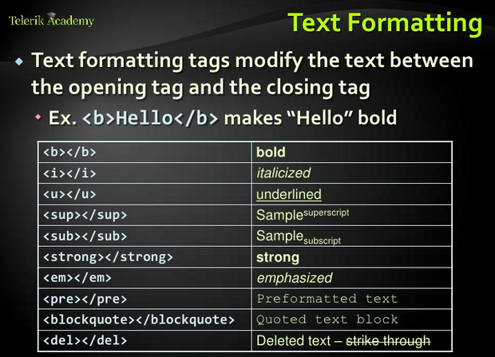
Text Formattimg

Slide 36
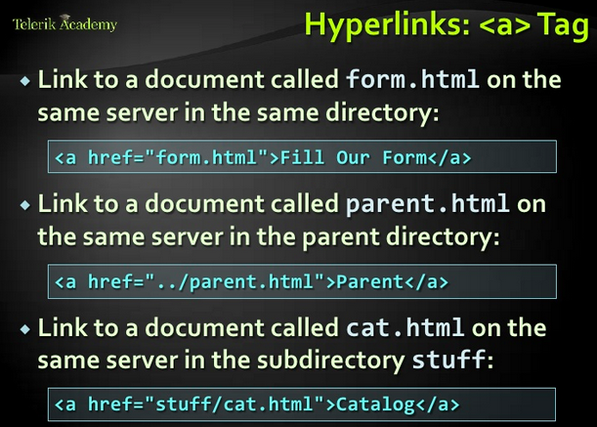
Hyperlinks

Slide 37
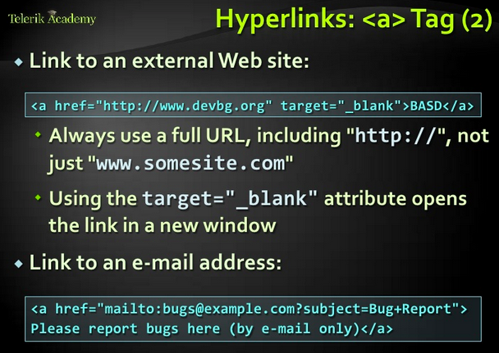
Hyperlinks(2)

Slide 38
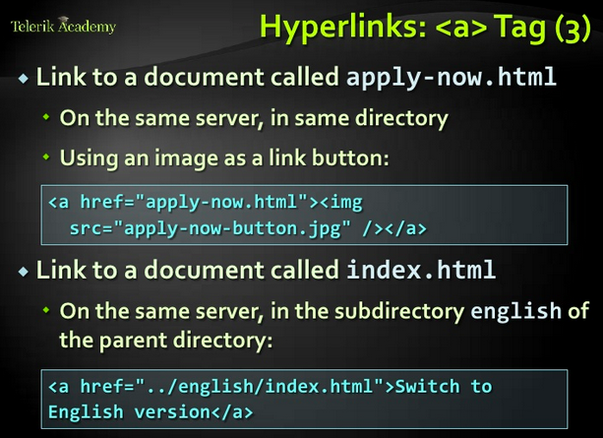
Hyperlinks(3)

Slide 39
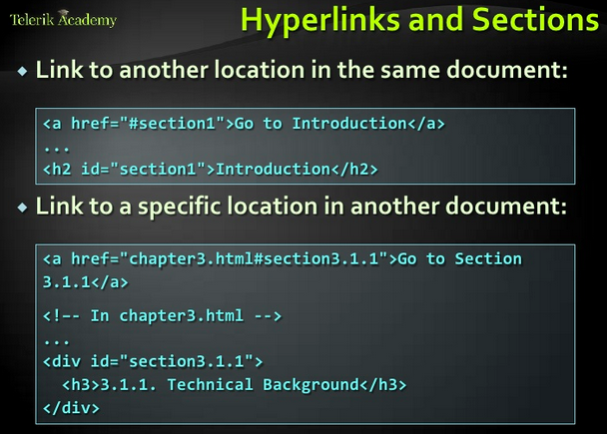
Hyperlinks and sections

Slide 40
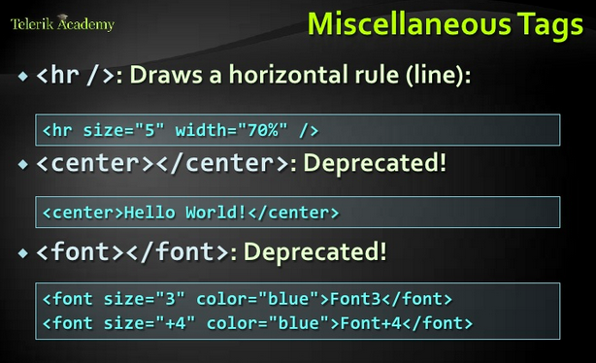
Miscellaneous Tags

Slide 41
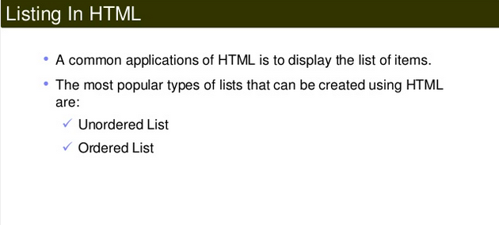
Listings

Slide 42
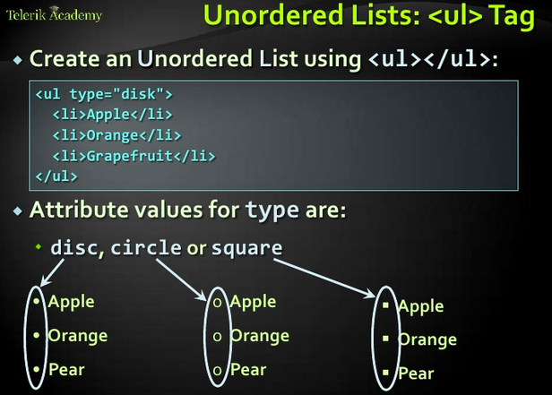
Unordered Lists

Slide 43
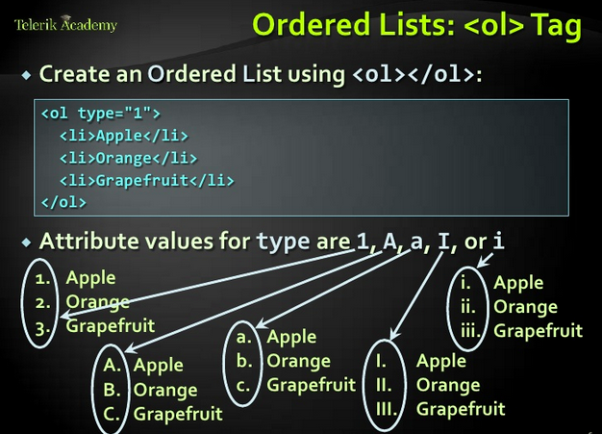
Ordered Lists

Slide 44
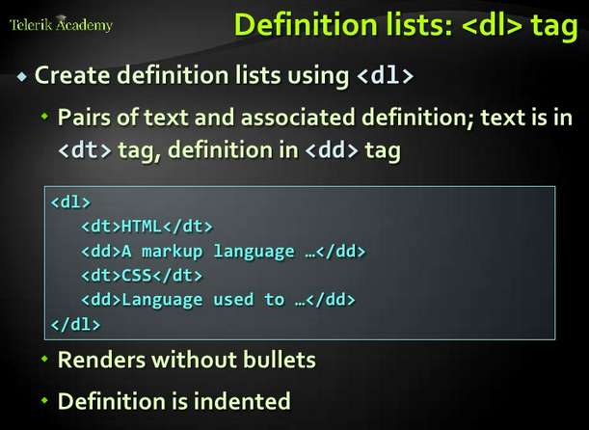
Definition Lists

Slide 45
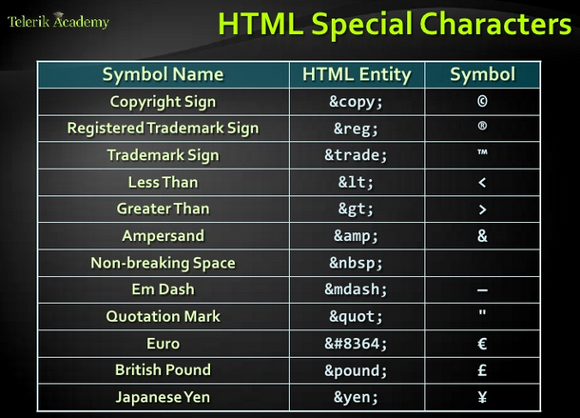
HTML Special Characters

Slide 46
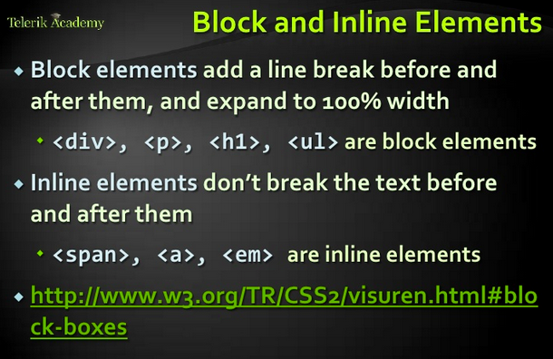
Block and Inline Elements

Slide 47
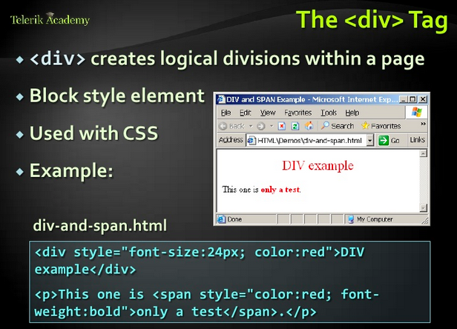
Div Tags

Slide 48
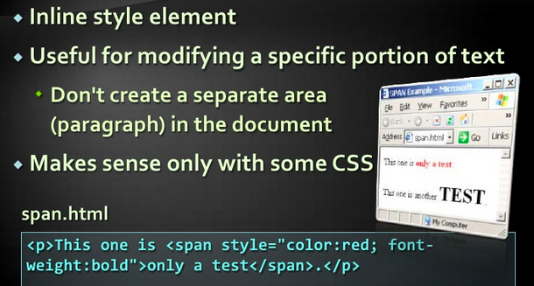
Inline Style Element

Slide 49
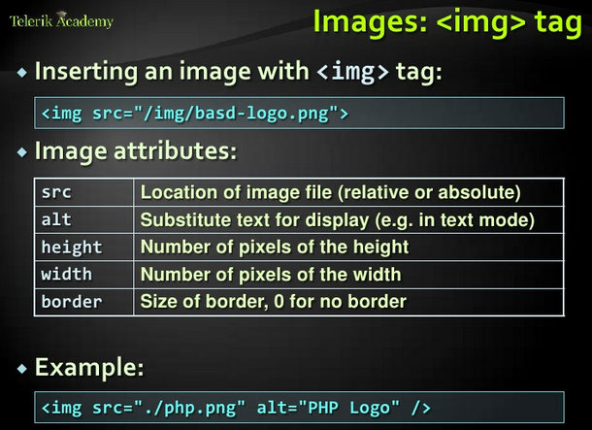
Image

Slide 50

Tables

Slide 51

Table – Hader,Body,Footer

Slide 52

Table-Data Cells, Header Cells

Slide 53

Table- Cellspace and Padding

Slide 54

Nested Tables

Slide 55

Table – Colspan and Rowspan

Slide 56

Table - Colgroup

Slide 57

Forms

Slide 58

Form - action

Slide 59

Forms - Selectors

Slide 60

Forms - Checkboxes

Slide 61

Forms - Buttons

Slide 62

Forms – Text Fields

Slide 63

Form - Attributes

Slide 64

Form – Input Field Validation

Slide 65

Form – Range

Slide 66

Form - FieldSet

Slide 67

Form - Labels

Slide 68

Form – Hidden Fields

Slide 69

Tab Index

Slide 70

Task - Create a webform

Slide 71

Task2 – Create a table

Slide 72

Task3 – Create a Grid Component

Slide 73

Task - Field Set & Nested Tables

Slide 74

Using Table

Slide 75

DHTML

Slide 76

HTML5

Slide 77

HTML5

Slide 78

Html5 Motivation

Slide 79

HTML5-Motivation

Slide 80

Removed Elements

Slide 81

Clear Syntax

Slide 82

No More Type Scripts

Slide 83

Content Editable

Slide 84

Forms

Slide 85

Placeholders

Slide 86

Email Inputs

Slide 87

Required Attribute

Slide 88

Pattern

Slide 89

Media

Slide 90

Audio Support

Slide 91

Video Support

Slide 92

Semantic

Slide 93

Figure Element

Slide 94

Elements Wit Meaning

Slide 95

Mark Element

Slide 96

Graphics

Slide 97

Canvas Element

Slide 98

Cookies

Slide 99

WebStorage

Slide 100

Types Of Web Storage

